Slide 1
FOLDER

Slide 2
In computers, a folder is the virtual location for applications, documents, data or other sub-folders. Folders help in storing and organizing files and data in the computer. The term is most commonly used with graphical user interface operating systems.
Folders can store and organize different types of applications, files or libraries. Folders can also contain other folders, which in turn could contain other folders or files.
Due to the manner in which folders organize and store data within the file system of the storage media, folders are also known as file directories or simply directories.
There is no limit on the number of folders or sub-folders that can be created. Upon opening a folder, one can see how the data or files are organized.

Slide 3
Although folders can contain large amounts of data, they do not take up any disk space. The reason for this is because folders are pointers to file locations within the file system of the computer.
Most operating systems, upon right clicking the folder, provide information on the folder along with its properties.
Folders can also be hidden from users, just as files can.

Slide 4
WINDOWS STORAGE FOLDERS
Windows 10 divides your computer’s hard drives into many folders to separate your many projects.
Windows gives you six main folders for storing your files. For easy access, they live in the ‘This PC’ section of the Navigation Pane along the left side of every folder.
The main storage areas in Windows 10 are Desktop, Documents, Downloads, Music, Pictures and Videos.

Slide 5
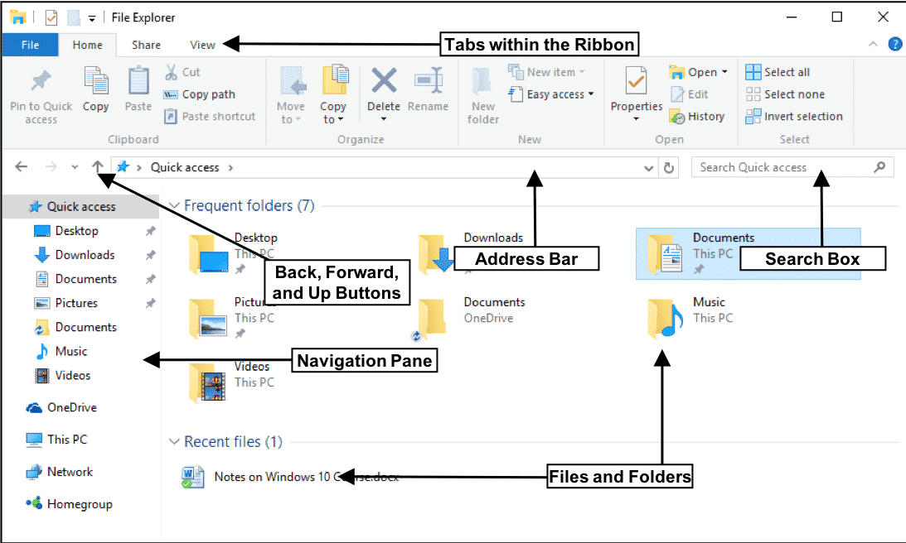

Slide 6
Folder title
In general, a file title should be:
Descriptive – it says what the document is about.
Helpful – it distinguishes the content of the folder from others on the same/similar topic.
Consistent – it follows the convention described in files.
Use short meaningful names.
No duplication

Slide 7
ESTABLISH CLEAR FOLDER STRUCTURE
Establishing efficient folder structure within your computer system is as important as establishing file naming conventions.
Clear folder structuring allows for the most efficient and predictable means of filing/finding a document.
Clear folder structure also ensures that all files pertaining to the same activity or subject are filed in the same place.
Be sure to establish folder titles which broadly reflects contents, so duplicate sub-folders are not required.
Office computer folder structure should reflect office functions.

Slide 8
